Slide 1
ANALYSIS OF AMAZON CELL PHONE REVIEWS

Slide 2
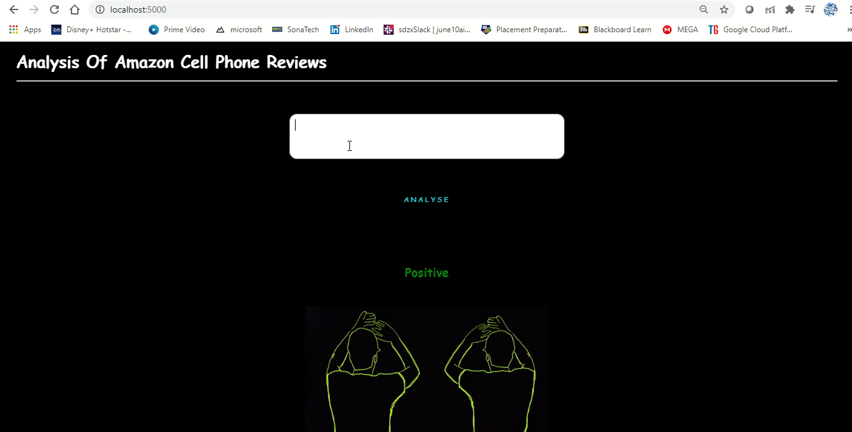

Slide 3


Slide 4


Slide 5
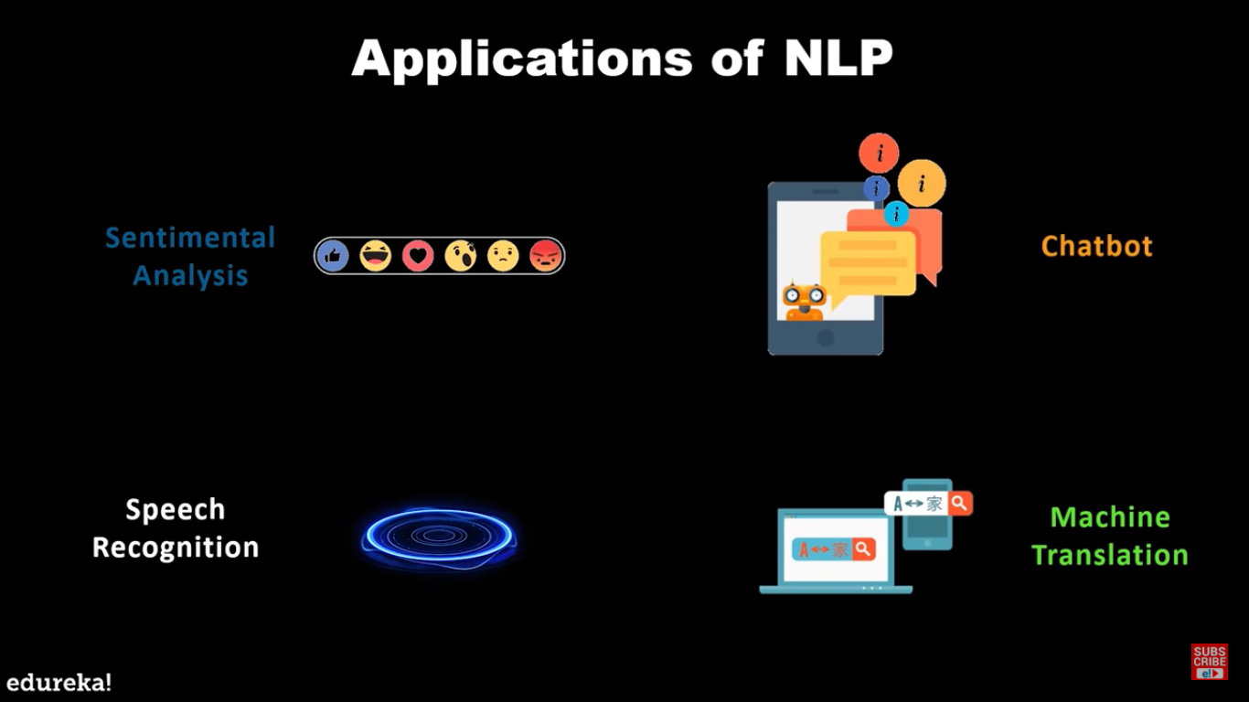
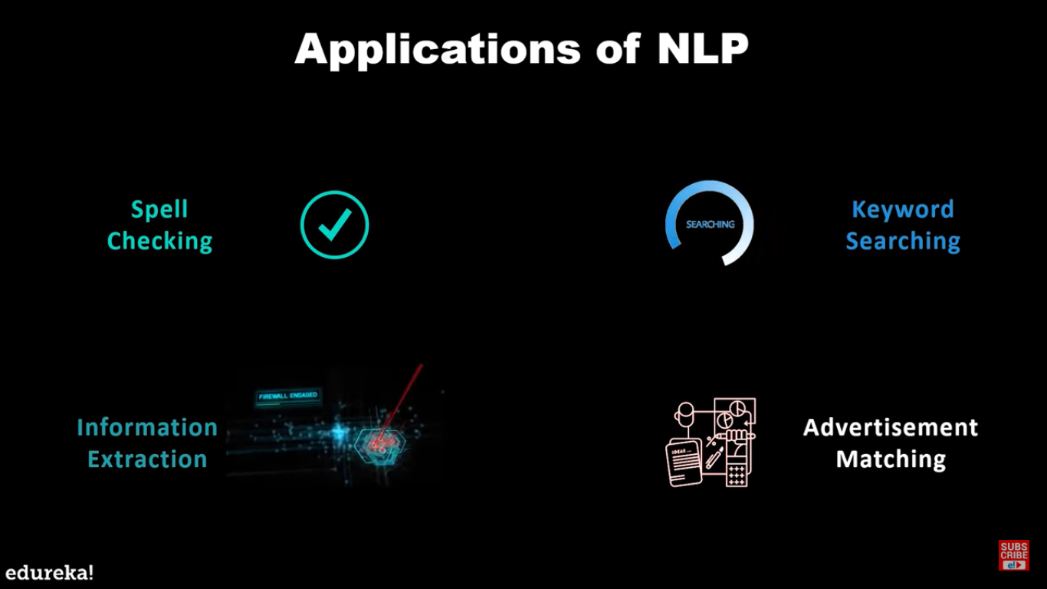

Slide 6
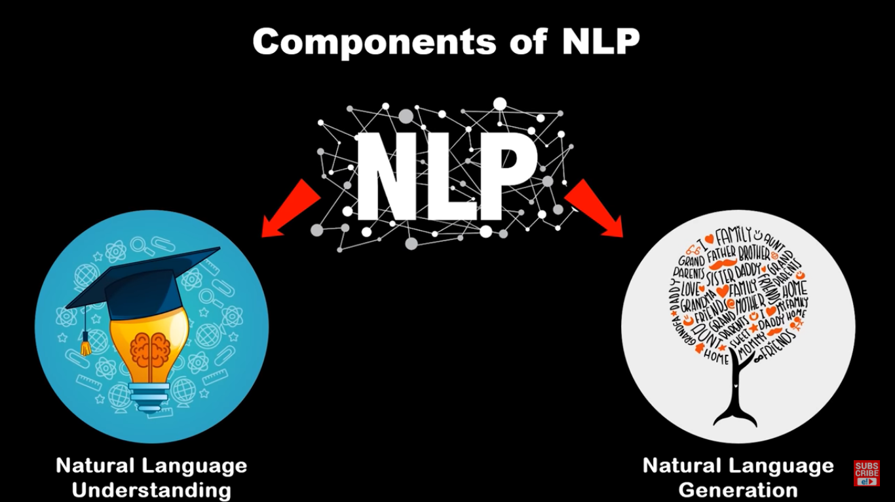

Slide 7
STEPS INVOLVED IN NLP
IMPORT LIBRARIES
READ DATASET
IMPORT AND DOWNLOAD PACKAGES
REMOVE REGULAR EXPRESSION
CONVERT TEXT TO LOWER CASE
SPLIT TEXT INTO LIST
STEM THE WORDS REMOVE STOPWORDS
TOKENIZE THE WORDS
SPLIT THE DATA TO X & Y
APPLY ANN STEPS
PREDICT MODEL
SAVE THE MODEL

Slide 8
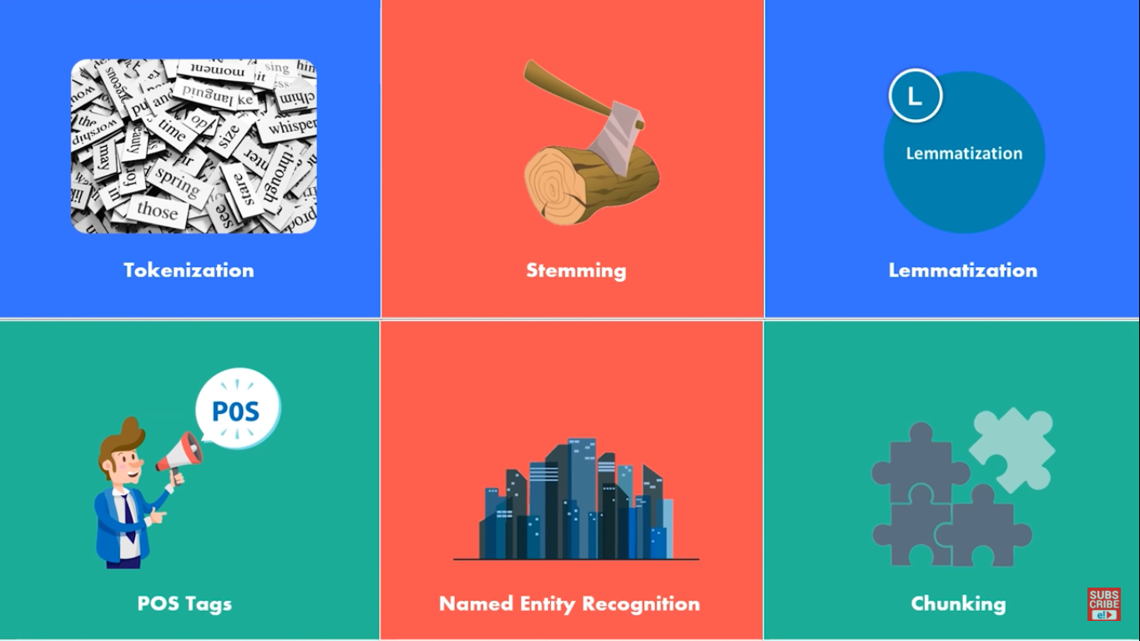

Slide 9
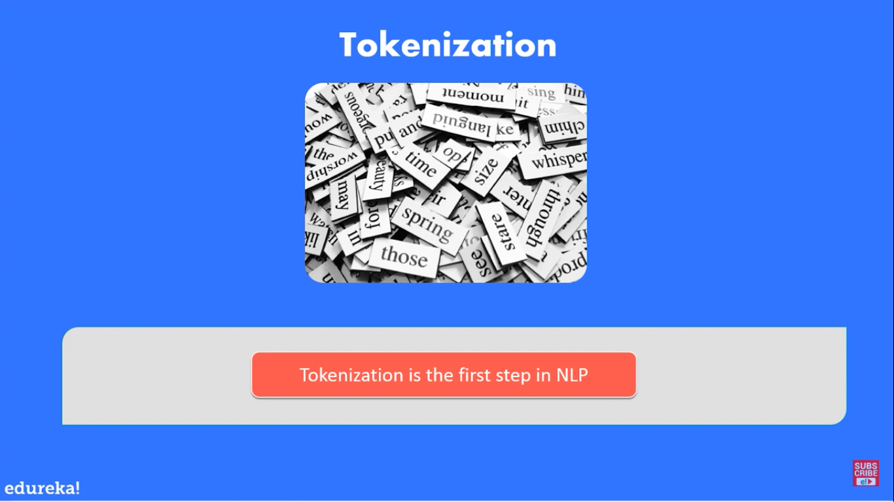
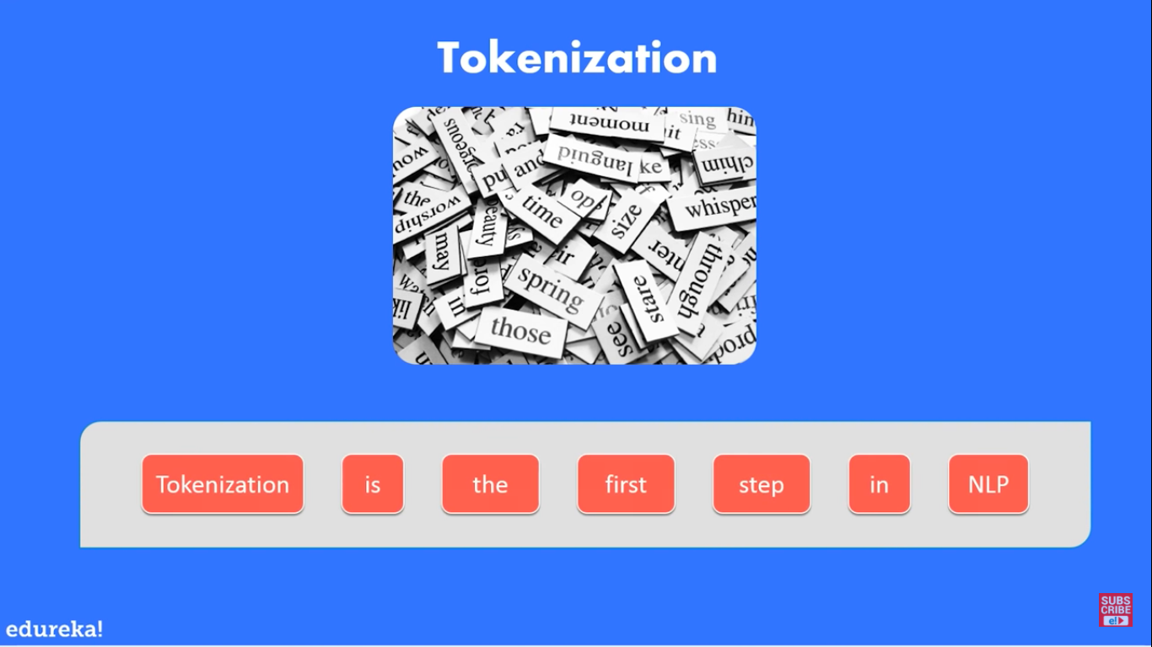

Slide 10
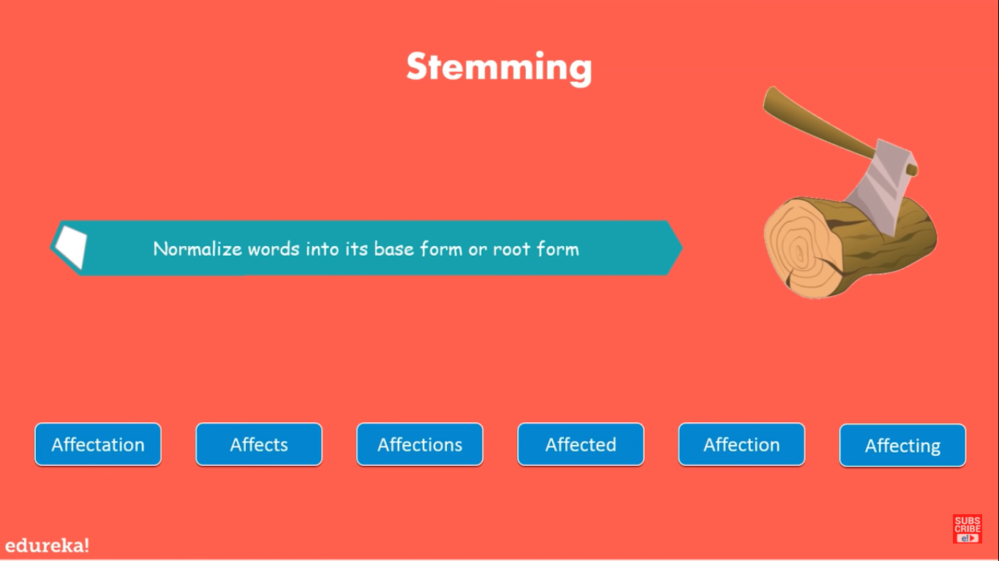

Slide 11
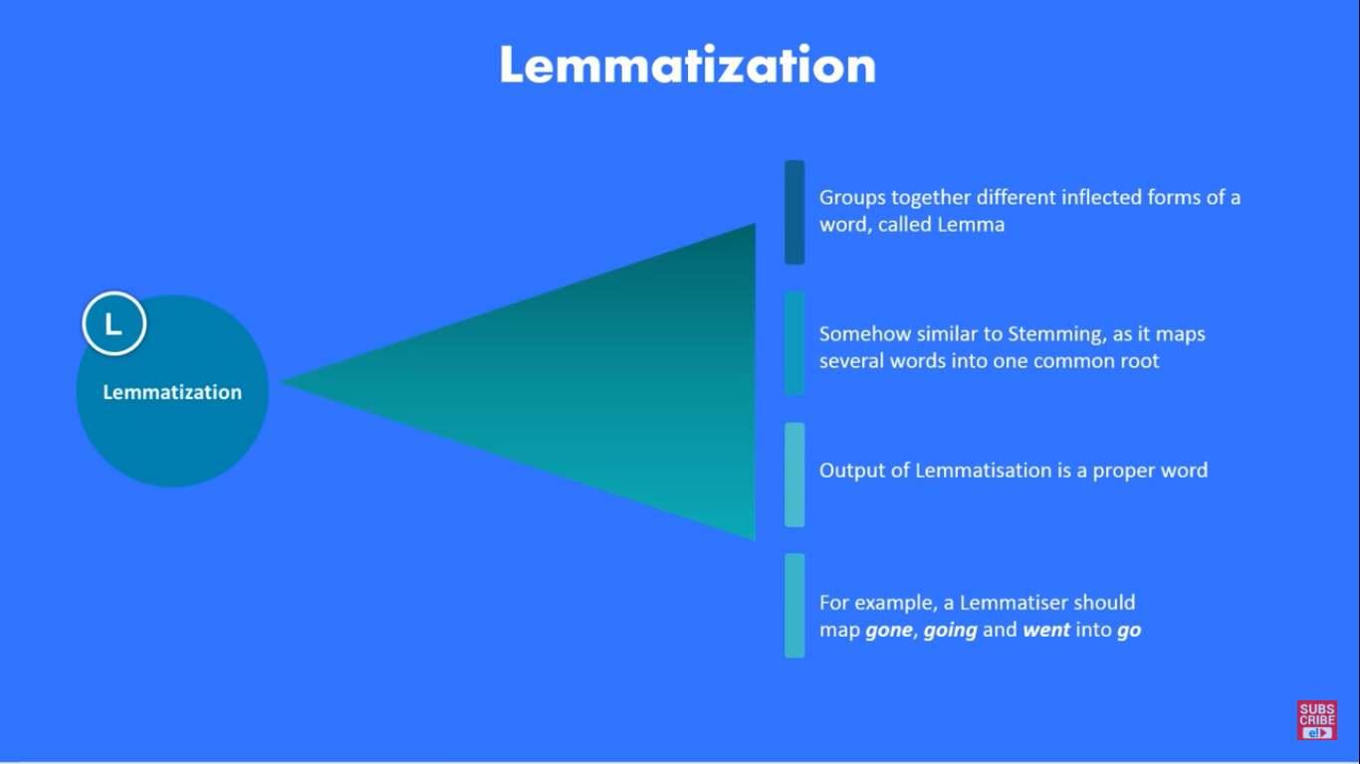

Slide 12
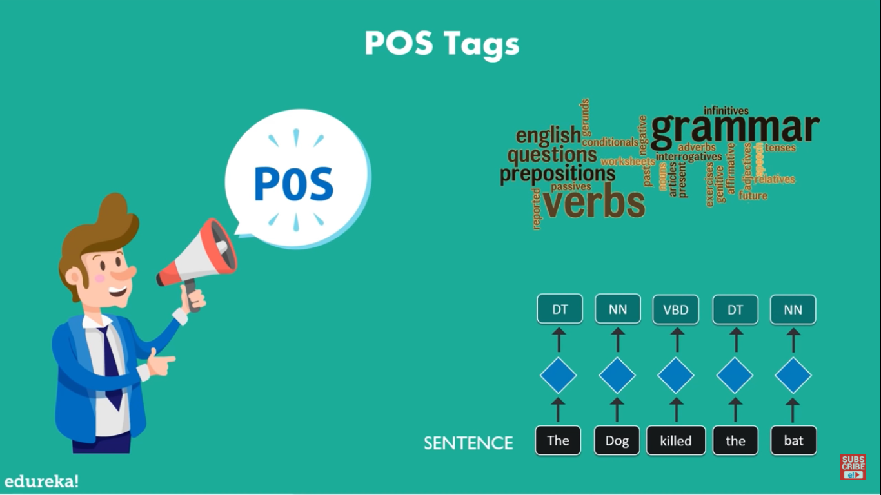

Slide 13

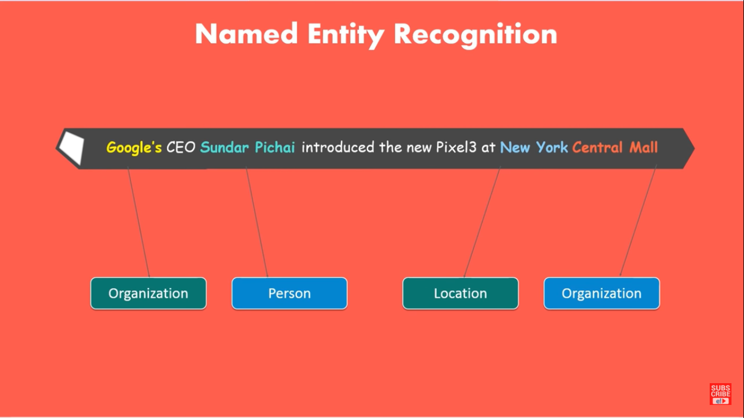

Slide 14
